Slide 1
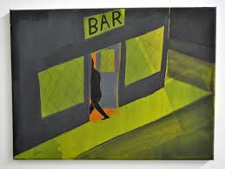
A theoretical conversation…
“ Two strangers meet in a bar and…”

Slide 2
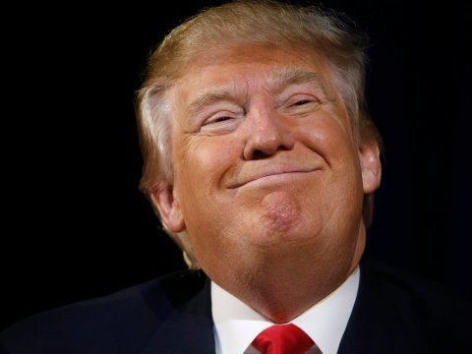
First, imagine if the world of politics came alive …as a single person
No… not HIM!

Slide 3
Let’s call this person… “Paul”
Politics personified

Slide 4
Now, let’s imagine the world of zoo decision makers symbolised as one single person… Let’s call her… “Zoe”

Slide 5
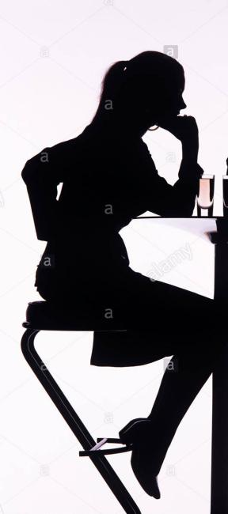
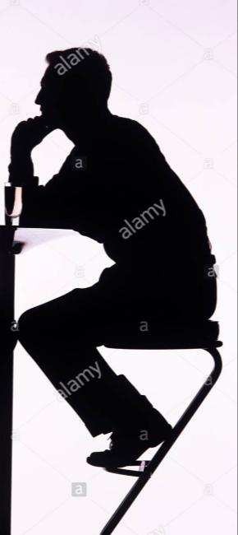
So Paul and Zoe bump into one another in a bar as strangers. Killing time, they strike up a conversation …
… What would they have to talk about…?

Slide 6
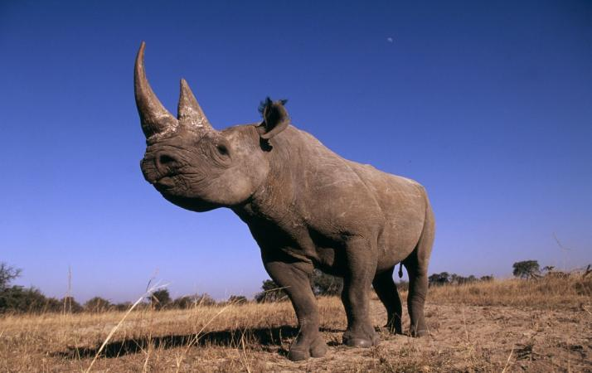
Zoe takes a sip from her glass, and would probably start with…
You know… I (i.e. “zoos personified”) do really important work around biodiversity and conservation…

Slide 7
Paul smiles back politely, and says… But thinks…
Great…. Really interesting…
Not a political priority…. Not really sure where to go with this.

Slide 8
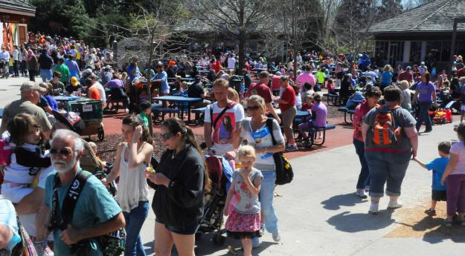
So then Zoe says…
I have 150 million visitors… and they come from all aspects of society, not just the well educated middle classes

Slide 9
Paul looks up, a sudden glimmer in his eye…
So you zoos are a way to communicate to all the people who elect ME?!
AND who pay taxes… AND to whom I need to get all kinds of messages..
Now you are talking!
Tell me more

Slide 10
So, encouraged by this, Zoe continues…
Well, I am an important part of the tourism and leisure industry

Slide 11
In reply Paul will certainly say…
Government is fully in support of our wonderful tourism industry
but, depending on the country, may actually think…
How important is tourism really…? More excited by advanced manufacturing, bio-technology…. digital industries

Slide 12
So then Zoe tries…
On the whole I am financially sustainable. Here today, and here tomorrow. Been around for nearly 2 centuries… No ‘feasibility study’ needed here

Slide 13
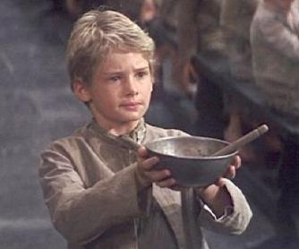
Now Paul draws his chair closer to Zoe
Hmm… So not the kind of organisation that needs constant propping up… a stable vehicle for all kinds of programmes or messages
UNLIKE all those ‘worthy’ high culture organisations that keep coming back to me again and again for money…

Slide 14
Zoe pitches…
Nearly everything I do is connected to
science

Slide 15
Paul gives a ‘tell me something new’ type shrug.…
Well sure, I know – you mean zoology, veterinary science and all that kind of “…animally stuff… “

Slide 16
But Zoe cuts him off…
Not just zoology, or even ‘just’ biology. Physics, chemistry, mechanics, maths all lie beneath the animal world. I can excite young people into those careers

Slide 17
And presses home her advantage
And I can be a ‘shop window’ for partner universities … placing their huge value firmly in front of the public… who, after all, pay for them

Slide 18
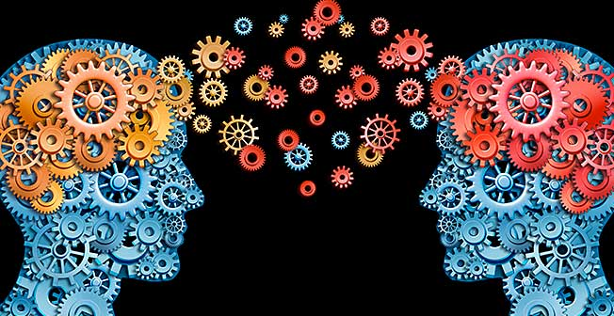
Now she has the wind behind her sails… and makes the audacious claim
I can even help in the business of innovation and translation of raw knowledge into prosperity

Slide 19
By this time Paul’s mind is working furiously…
Helps my country’s science base. Helps my citizens understand the importance of universities and research . Helps applied research to create goods and services…
GOOD FIT with my policy objectives
Perhaps I‘ve been overlooking something here..

Slide 20
Then there are my links to other nations…zoos are not only about ‘here’: they are normally about ‘there’

Slide 21
Paul pretty much shrugs again, glancing at his watch
Well… yeah, yeah you do a great job telling visitors about the wonderful wildlife of Africa, Asian and Latin America
Getting a bit bored again now

Slide 22
Zoe
No, no... You don’t quite understand... Yes the experiences I offer do start with the natural heritage of those places…

Slide 23
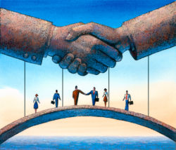
But my projects can move on to talk to my visitors (remember …your voters)… about the wider culture of those countries… And their societies And their economies
But my projects can move on to talk to my visitors ( your voters)… about the wider culture of those countries… And their societies And their economies

Slide 24
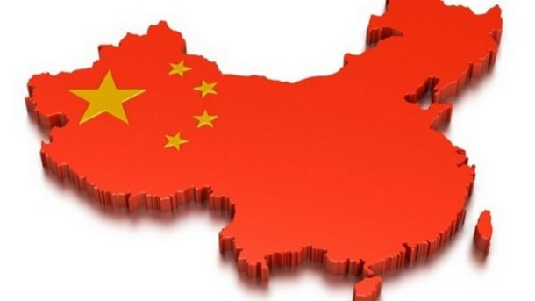
And Paul thinks…
So you can help my country and my government makes new types of science and cultural links with emergent super-economies LIKE CHINA!
Which in turn can mean more trade links …and not just China. India, Latin America, Malaysia, Indonesia, South Africa … !

Slide 25
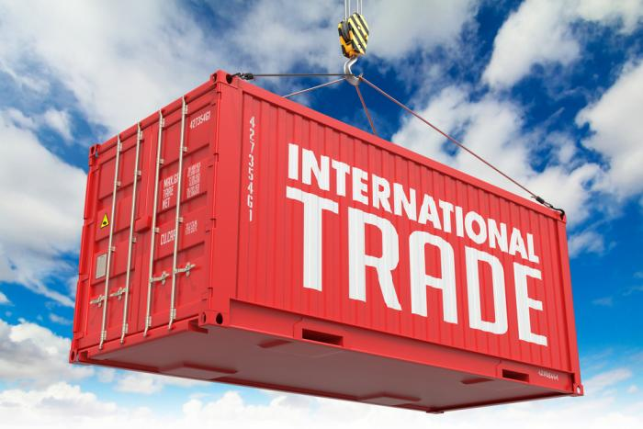
This is the real prize for Paul here..
Hmmm…

Slide 26
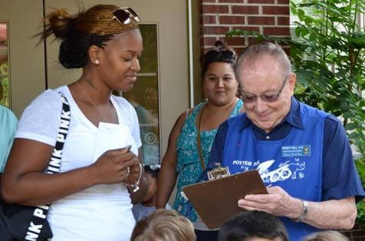
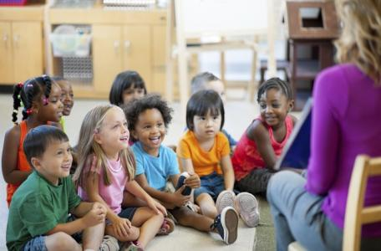
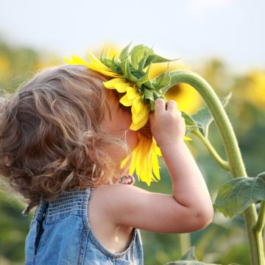
Then there is my social role…. Think of zoos as large green oases in the middle of society… where all types of people mix together… in volunteering, in community activities, in confidence building
or to put it more plainly…
I TURN YOUR ELECTORATE INTO HAPPIER PEOPLE
a huge potential to create new ‘social capital’… to bring divergent people together … higher standards of mental, social and physical wellbeing

Slide 27
I have to mention environmental technology… water conservation… energy efficient buildings
Where better to introduce a huge demographic to the carbon neutral society of the future…. Than my 250 sites across Europe where people already come to learn about the environment

Slide 28
Zoes reins herself in a bit…
I could probably go on… but sometimes ‘less is more’

Slide 29
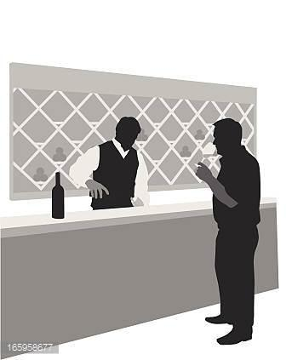
And Paul does indeed need a break after all this, so he goes and orders another round of drinks
Hmm …Lot to think about…

Slide 30
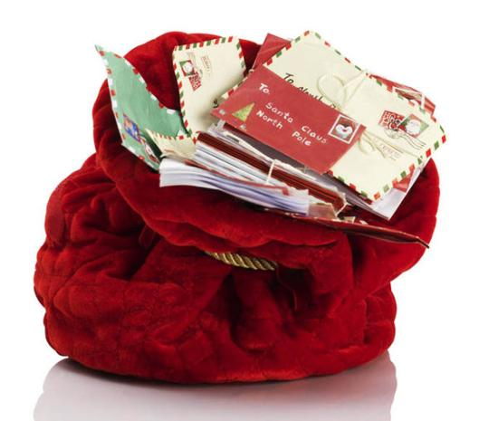
When they sit down again, the shoe is in the other foot…
Zoe, can you guess what is the single subject on which I, as an elected representative, get the most letters..?

Slide 31
Zoe
Erm, Not sure… Maybe employment..? housing..?

Slide 32
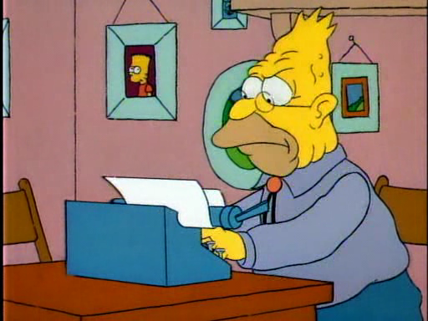
Nope!
Animal welfare
And (rightly or wrongly) quite a lot, I am afraid are about you, Zoe!
You are not one of those nice, easy, completely uncontroversial subjects….like, say, museums or parks …. Or, I dunno …. donkey sanctuaries
And that ‘Z – word’ sometimes makes it a bit difficult for me to support you

Slide 33
Zoe sighs in resignation…
Yeah, I get those letters too!
And yet the public vote with their feet
The overall trend over the last few decades is for more people to attend good zoos
But you are right. There is such a thing as a bad zoo … certainly in the past. I have no reason to be complacent

Slide 34
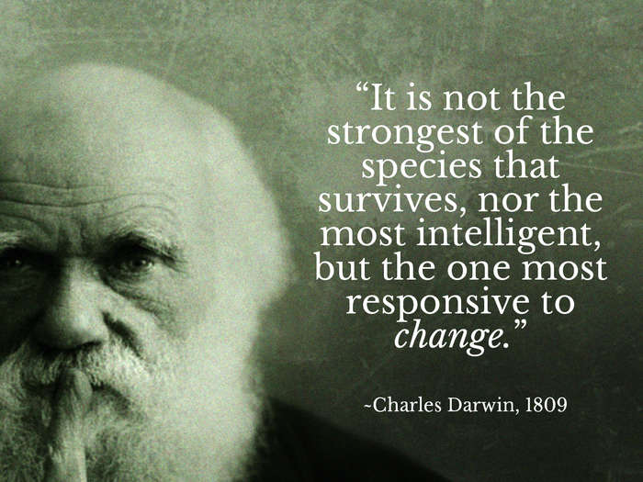
But the thing is, Paul, I am evolving…. And pretty fast now… there all kinds of wonderful innovations in all the different bits of me across Europe
I would, after all, be a pretty strange creature, given my links to this guy’s ideas, if I did not strive to change, and to explore new ideas and new ways of doing things…

Slide 35
It is all coming together..
Access to voters
Financially stable platform
Help with links to trade partners
Promotes sciences, universities and innovation
Raises “gross national happiness”
A type of organisation especially open to imaginative change

Slide 36
It strikes me Zoe, that with my help you could evolve faster and further… help me with my agenda, whilst still staying devoted to your biodiversity mission
I really could not have put it better myself, Paul!
Think this could be the beginning of a beautiful friendship

Slide 37
And Zoe goes on her way, thoughtfully…
Well that went well … But what’s the next step?

Slide 38
Thanks for listening John Regan, Coordinator ‘New Zoo’ movement
And, by the way, should you ever want a chat, mine
is a gin & tonic!
And apologies to anybody whose images I swiped from Google Images
http://www.newzoo.org.uk/

