Slide 1
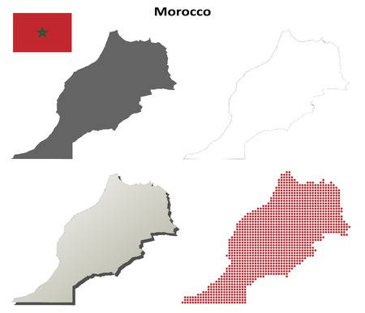
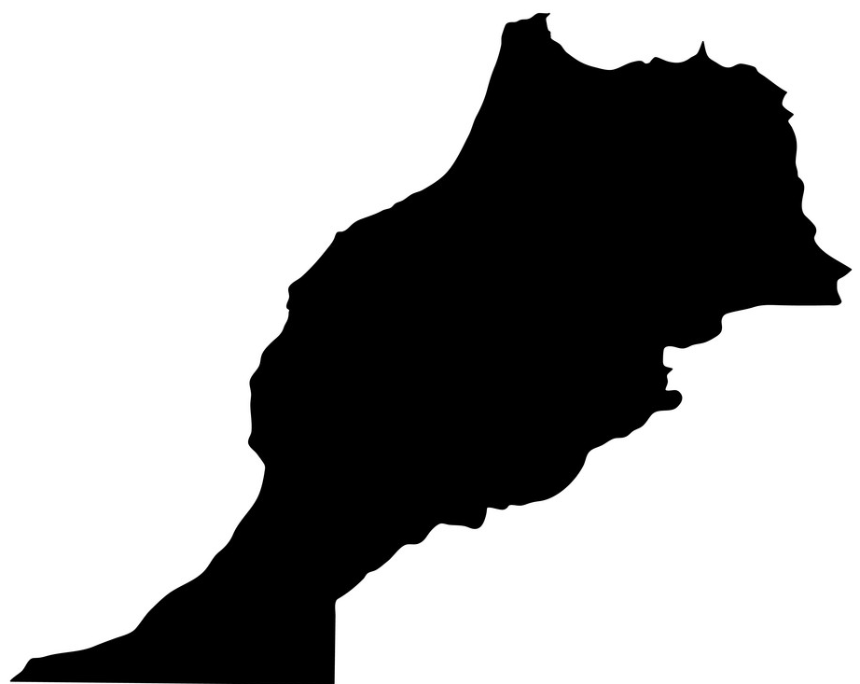
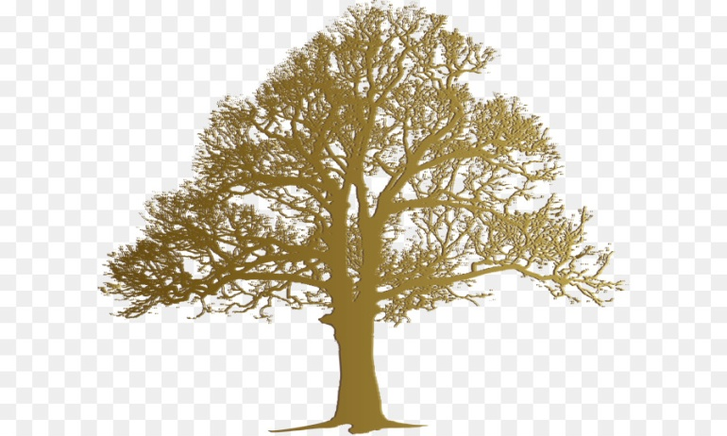
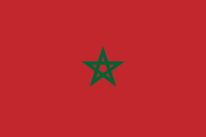
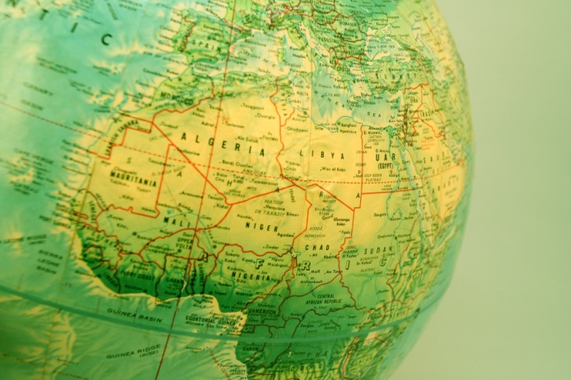
Bio Parc MaGhreb
A celebration of all that biology means to Morocco & its region: past, present and future

Slide 2
360 degree magnet or similar symbol

Slide 3
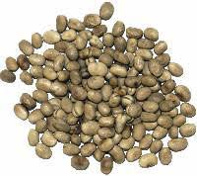
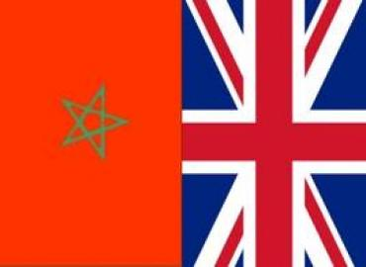
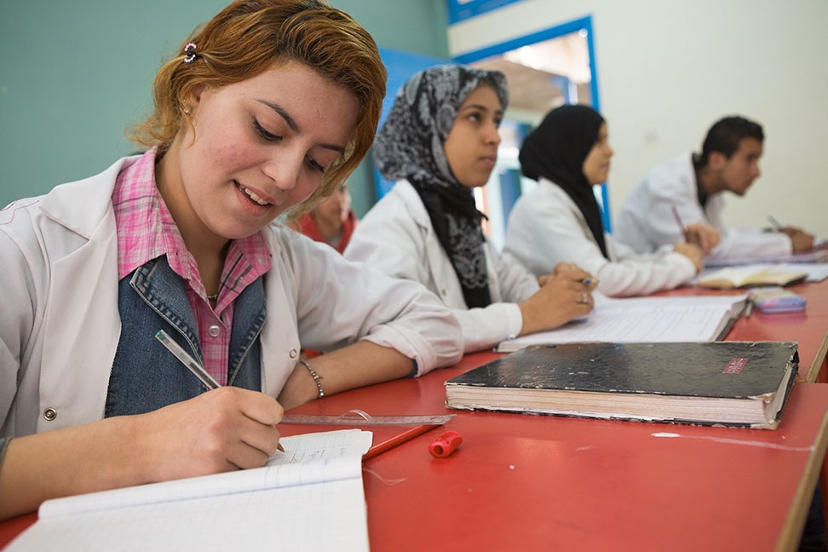
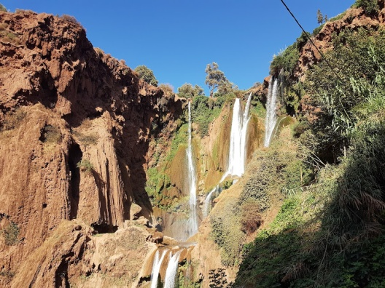
Some initial ideas & explanations in infographic form…

Slide 4

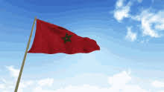
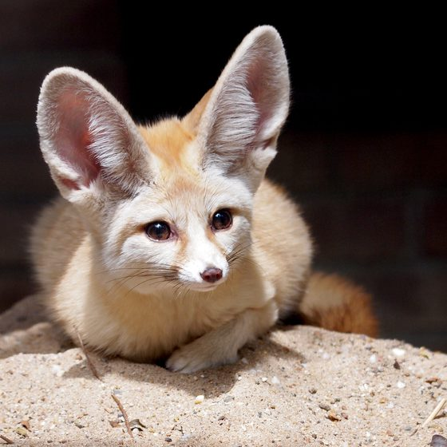
Contents…
Overall concept
Benefits for stakeholders and interested parties
Some likely questions
Conclusion

Slide 5
1. Overall concept
Projection of the very ‘soul and pride’ of Morocco on a global scale in the context of biology & environment
Bringing all aspects of Moroccan society together through shared natural heritage
Driven by public delight in the living world, but a platform for many economic, social & cultural agenda associated with nature
A high profile financially sustainable attraction affirming/promoting the bioscience, biodiversity & nature of Morocco and its wider region

Slide 6
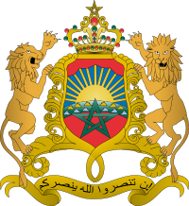
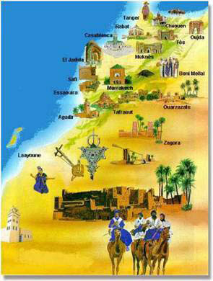
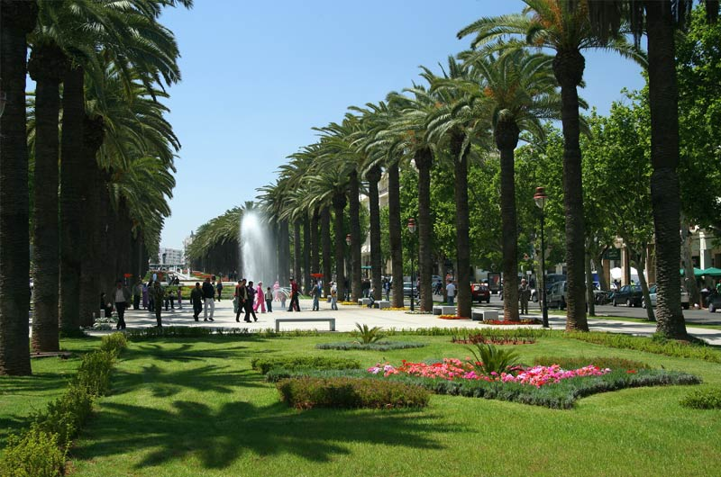
Specific deliverables…
Highlighting Morocco’s natural and biological heritage and culture
Biology is a vital component of Morocco’s cultural identity. In its arts, crafts, myths and stories, Morocco’s overall heritage is inextricably linked to its biological roots
Encompassing Morocco’s diversity, traditions and identity
Biology and nature are universal topics, providing an opportunity to unite Morocco’s rich and diverse range of cultures, and offering ‘buy in’ for a shared future
Social and community benefits for Morocco’s people and visitors
As an attractive urban green-space, Bio Parc will provide an appealing location for people to meet and socialise, engendering civic pride, responsibility and integration

Slide 7
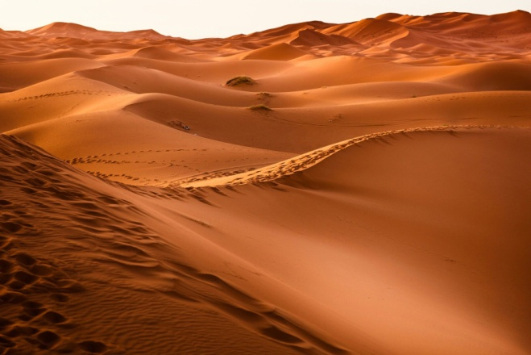
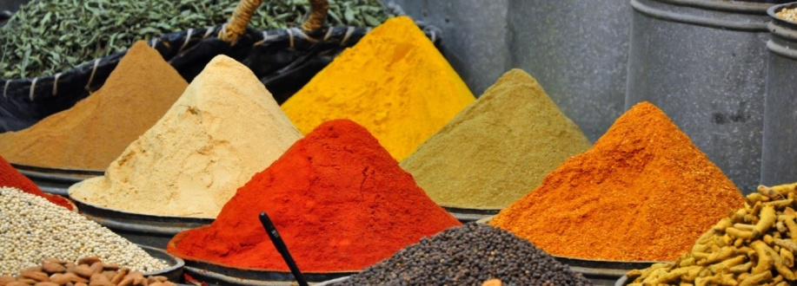
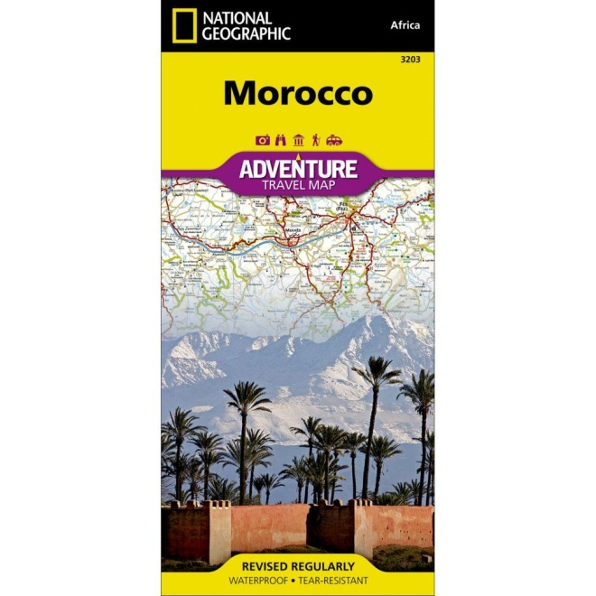
Deliverables continued…
A platform to explore Morocco’s macro-environmental issues
Climate change, soil erosion, deforestation and drought are crucial matters. An opportunity to present, interpret and debate these topics to a large & broadly based constituency.
Spotlight on Morocco’s agriculture & horticulture
Benefitting Morocco’s tourism economy
The natural world is the perfect theme through which visitors can engage with topics such as Morocco’s economically important crops.
Bio Parc will act as a tourism hub, encouraging wider engagement with Morocco’s natural attractions. Drawing visitors with an innate interest in natural and wild experiences.

Slide 8


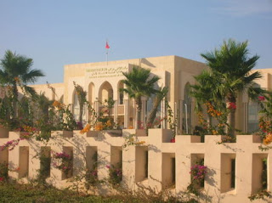
Deliverables continued…
Promoting Morocco’s technological and scientific economy
Promoting biotech & science sectors, advocating for technical innovation & research, realising the growth potential of biotech, crop science, pharma & microbiology sectors.
Supporting Morocco’s young people
Bio Parc can not only provide direct opportunities for young people and students eager to work with flora and fauna, but promote vocational training and signpost this audience towards the much wider bio- and enviro-sector.
Benefitting Morocco’s universities
Bio Parc would support Morocco’s universities, specifically research, technology, teaching and student recruitment, including partnerships with leading higher education and research institutions in the UK

Slide 9
Bio Parc Maghreb: a unique international landmark
Possible physical components all combining within Bio Parc
A botanic gardens.
A sculpture park and natural history museum.
A public park and gardens which serves as a community amenity.
A small conservation orientated collection of the native zoological jewels of Morocco and the Maghreb.
A scientific research and innovation faciility
A public venue for the appreciation and understanding of science.
Iconic architecture: a distinctive skyline instantly recognisable marketing image.

Slide 10

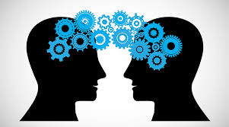
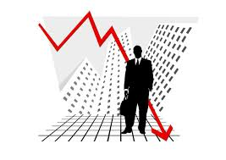

2. Main stakeholders: who might take an interest and why?
Senior political figures & national identity stakeholders
As an iconic national symbol showcasing Morocco’s proud national culture and identity
Advocates for enhanced UK/Morocco links
As enhancing political, economic and cultural relationships.
Morocco’s investment & economic stakeholders.
In attracting international investment & raising national profile/ commercial identity
Science & innovation community: industry, government, research institutions
In respect of public appreciation and engagement in science & tech sectors. Developing knowledge translation

Slide 11




2. Interlinking stakeholders cont.
Biodiversity stakeholders.
Re conservation of Morocco’s zoological natural resources.
Culture and heritage stakeholders.
In widening access to & awareness of Morocco’s culture and heritage as intertwined with natural world
University & education stakeholders
In championing of Moroccan universities and new partnerships with overseas universities
Tourism stakeholders.
Inspiration gateway to natural tourism venues in Morocco, Maghreb and North Africa as a whole

Slide 12
3. Some anticipated questions
We have looked at the preceding Bio Parc Maghreb details
These make a compelling case. Bio Parc clearly fits a number of priority agenda for Morocco
Inevitably, however it raises further questions, and we need clarity on a few issues…

Slide 13

First of all is Bio Parc
A science discovery centre…?
Or an innovation centre…?
Or a botanic garden…?
Or a science research centre…?
Or a community park…?
Or a zoological experience…?
Or a stunning piece of bio-architecture…?
Or a ‘temple’to sustainable technology and lifestyles…?

Slide 14
Multiple good things for Morocco wrapped up in one, single, coherent package
A science discovery centre
A research facility
A zoological experience
An innovation centre
A botanic gardens
A community park
A fantastic piece of bio-architecture
Yes, all of these things

Slide 15

Okay, so in a way, Bio Parc will be a bit like this useful little thing here in my pocket..!?
… Yes, that’s as good a short hand metaphor as any.

Slide 16
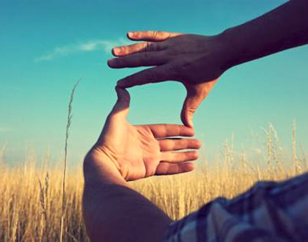
That is clear
But we still have some trouble visualising Bio Parc
What exactly would it actually look like…?

Slide 17

Well, we don’t know all of that yet either
At least not in any detail
Not until a fairly comprehensive business plan is complete
But in terms of physical layout, we might envisage…

Slide 18
An inner ‘introductory’ area: visitor reception facilities, intensive experiences, research labs & innovation facilities
And then designed trails carefully leading through garden areas into virgin habitat
So the hard footprint is metaphorically and literally embedded in the very asset it celebrates and protects
Semi natural landscape (potentially rural)
Lower level botanic surrounding area
Core hard footprint: visitor and research buildings
Fully wild or natural habiat

Slide 19
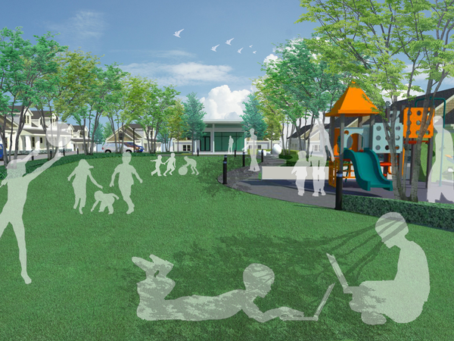
The intermediate areas might have an overall park like setting…
Themed to biology, biodiversity & the environment…
A shared convening space for all kinds of Moroccans and visitors to the country

Slide 20
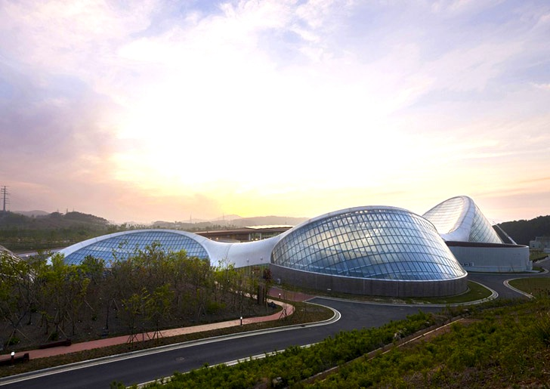
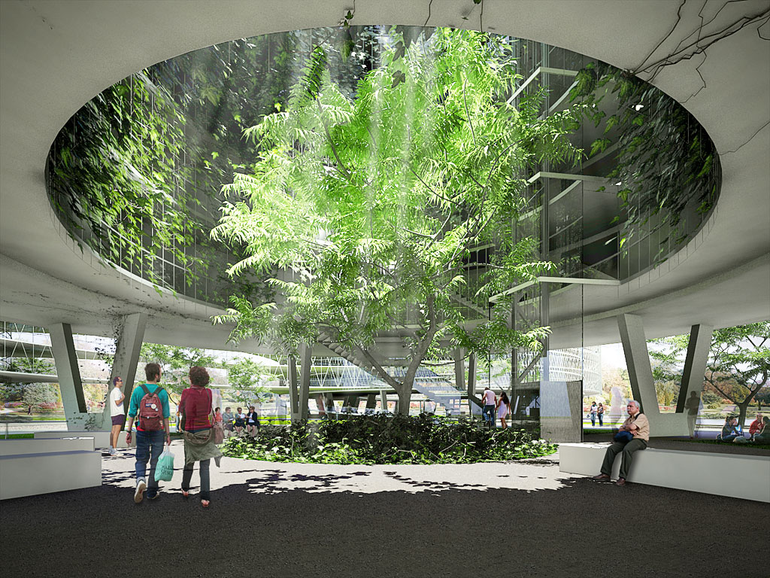
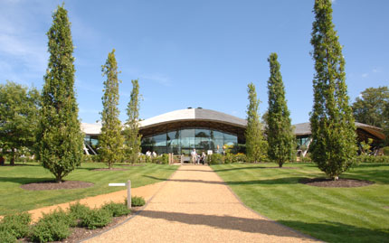
Within which specific structures and facilities would serve Bio Parc’s deliveries as defined by a future business plan

Slide 21
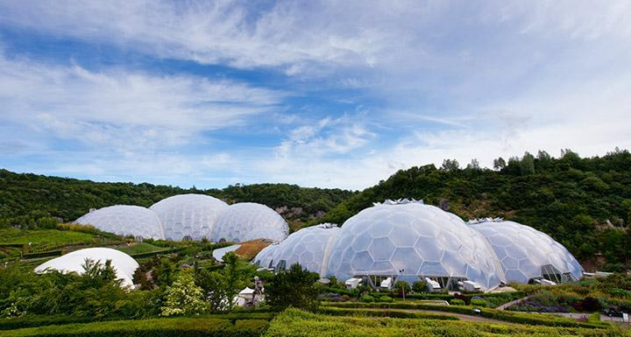
Another useful (…but ultimately limited) short hand is Cornwall’s Eden Project http://www.edenproject.com, a potential partner in helping to design and deliver Bio Parc Maghreb.
There will certainly be lessons to be learnt from the experience there. And there may be some direct parallels as Bio Parc begins to take a specific shape. Interested parties are certainly urged to accept our invitation to a VIP visit.

Slide 22
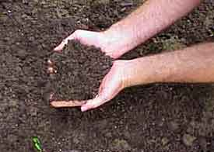
However, although Bio Parc is about a partnership of the best experts in Morocco and the UK,
Bio Parc must be Moroccan!
Deeply rooted in the culture, nature, needs and practicalities of the country and its people
Eden may be a useful initial reference, but Bio Parc Maghreb will ultimately be ‘one of a kind’ and unique in the world

Slide 23

A few more questions …
Where will it be...?
How big….?
Who exactly will be the audience, and so forth……?

Slide 24

All inevitable issues….
But these, and many other matters, will have to wait until all the stakeholders sit down together
And something like a business plan is produced

Slide 25
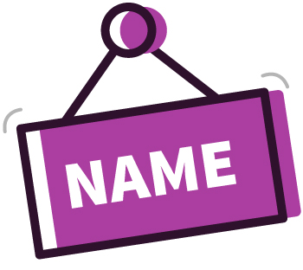
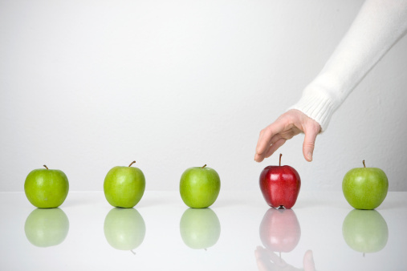
Why did you choose the name “Bio Parc”..?

Slide 26

We considered lots of expressions, but “bio” and “parc”seemed to be the two most important elements
We know that sometimes bio parc is used just to mean ‘zoo’; and other times it refers to a bioscience industrial park.
Both of these are definitely misleading.
So Bio Parc Maghreb is certainly a working title only.

Slide 27
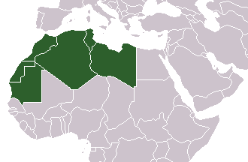
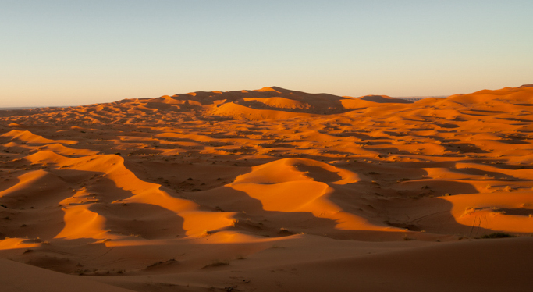
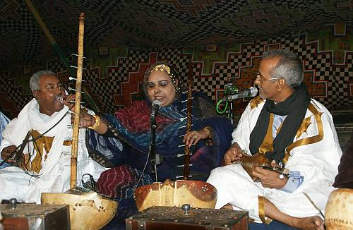
…well, nature knows no borders of course…
And why is it “Bio Parc Maghreb”, not “Bio Parc Morroco”..?

Slide 28

And then the Kingdom of Morocco might rightfully see itself as a lynch pin state for the region, leader for the wider North African theatre
A ‘gateway’ to a broader offer in shared natural & cultural heritage
And, should politics and peace allow, to a future wider economic community and commercial corridor

Slide 29
So the project may wish to lay a claim through its name to a natural heritage wider than Morocco’s political borders.
Or not...?
A future decision for Morocco and Moroccans.
“Bio Parc Maghreb”
“Bio Parc Morocco”
“Some other title to emerge”
?

Slide 30

In closing, how should we really think about Bio Parc in terms of its scale, its importance and its degree of aspiration?
How would it compare alongside other major cultural and science projects?
In both Morocco and in other countries…?
And both now and in the past…?
4. Conclusion

Slide 31
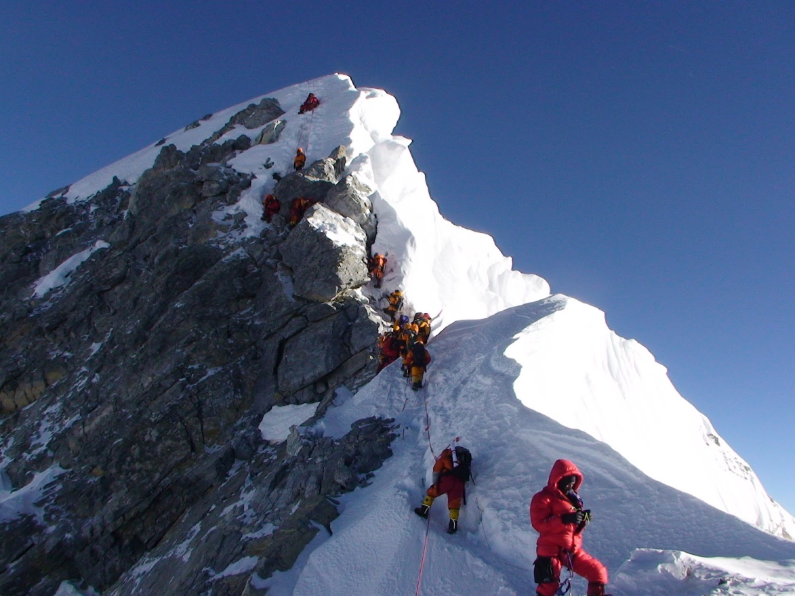
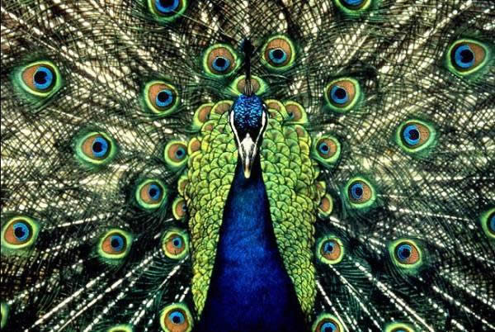
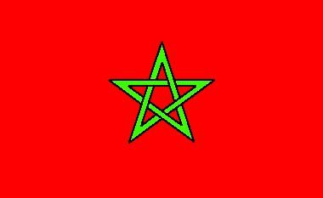
We should be positively audacious as to the status of Bio Parc
Ranking it as a major symbol of the nation’s very identity and resurgence
The equivalent of the great museums, sports stadia, art galleries, opera houses and concert halls set up by the visionary figures of the nineteenth and twentieth centuries

Slide 32
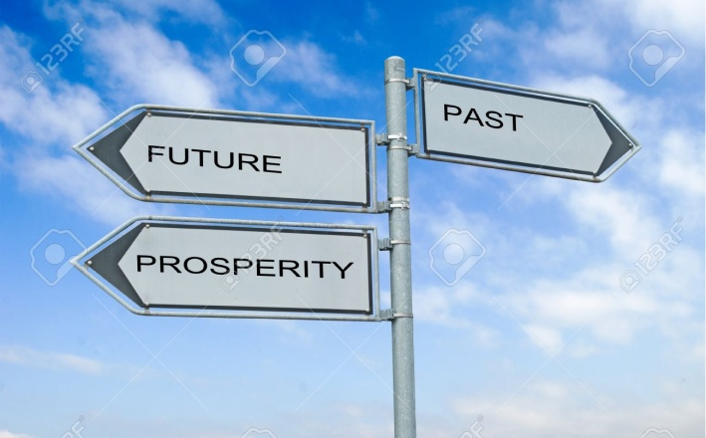
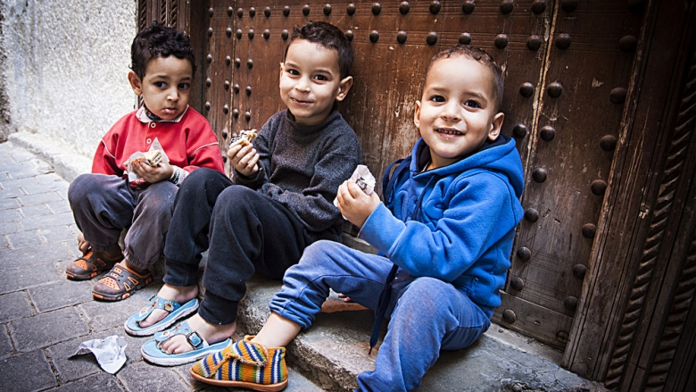
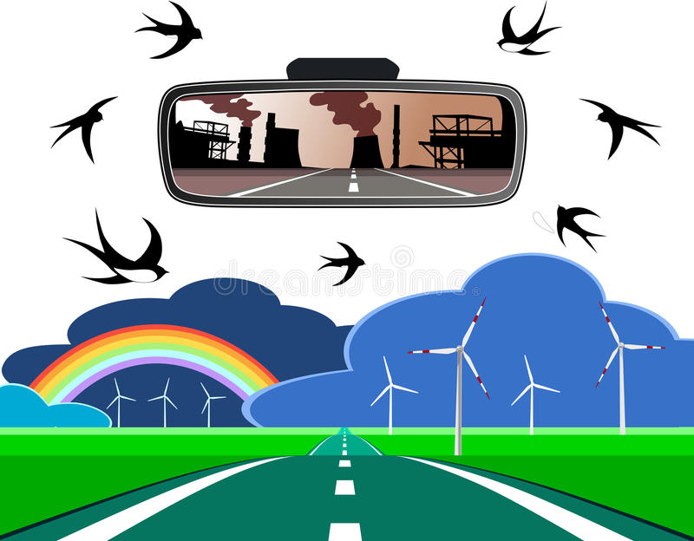
But Bio Parc is a more contemporary concept.
About the future, not just the past.
About the concerns and passions of ordinary people, not just educated elites
Rooted in the practicalities of Morocco’s future prosperity, not just high culture

Slide 33
In bringing together all these different elements
All related to biology and the environment
And all critical to the future of the nation and its people
Bio Parc will be a powerful symbol of Morocco itself

Slide 34

ENDS

Slide 35
P.S.
In recent mnths fresh archaolohogical evidence suggesred hat the human species might have origintad in part in Morroco

