Slide 1
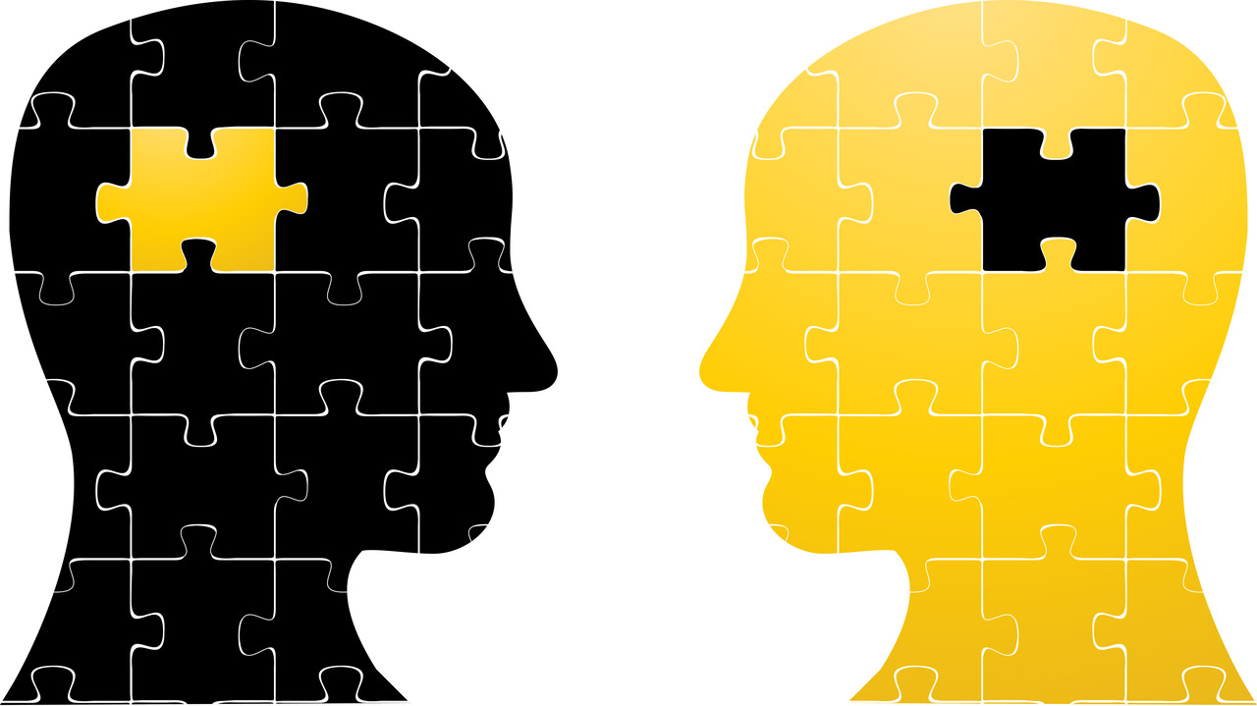
How your zoo director should talk to your politicians
MONEY
about

Slide 2

And get your Mayor to
give you funds for your zoo masterplan
...maybe starting with a site wide plan for water management?

Slide 3

“The Zoo Director’s Dilemma”...
But I should really do this as part of my overall master planning
Oh God... I really need to sort out all my bloody water problems!
?
Easier though to develop the Zoo bit by bit.
And anyway where do I get the money for ANY of this?
Each exhibit or area separately?

Slide 4

Meanwhile the mayor is expecting a visit from the zoo director to ask for money and is thinking...
Yes I know that all things that the zoo does - biodiversity, tourism, etc. are important.
.
But my access to funds is limited.
And I have other priorities

Slide 5
Like getting elected again!
How exactly is helping the Zoo going to help me to do that?

Slide 6
50 MILLION KRONA FOR 10 DUCKS!!
And I think she is going to ask me for funding for a new pond!

Slide 7
Or anything else
So I am NOT going to give them funds for better water management
When she or he comes I will pretend to listen, smile politely and then wave goodbye.

Slide 8

So now the Zoo Director and the Mayor do meet...

Slide 9
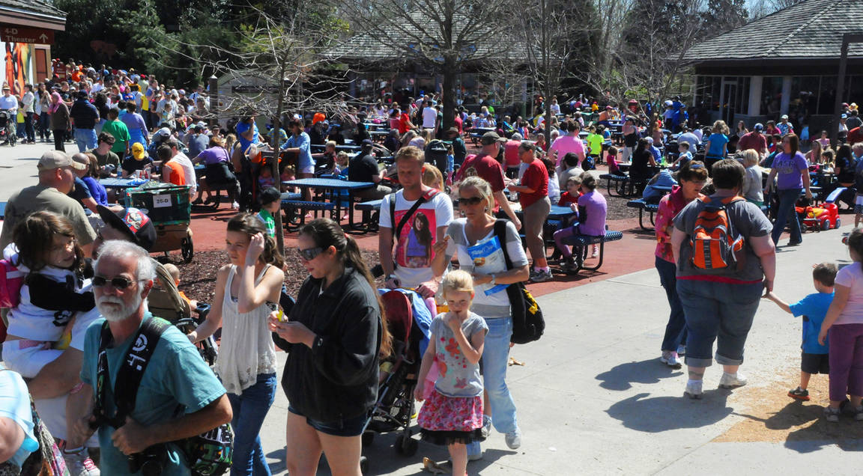
And wisely the Zoo Director begins with…
Look I have a huge number of visitors… and they come from all aspects of society, not just the well educated middle classes. They are your voters and taxpayers

Slide 10

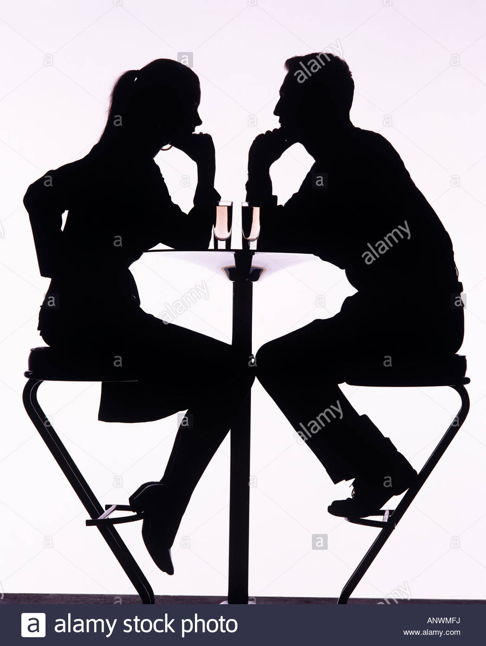
The Mayor looks up, no longer quite so ‘busy’, a sudden glimmer in his eye…
So you mean your zoo is a good way to communicate to all the people who elect ME?!
and who pay taxes… and to whom I need to get all kinds of messages to..
Suddenly I find you quite fascinating…
Tell me more

Slide 11

So then she tries…
On the whole I am financially sustainable. Here today and here tomorrow. Zoos have been around for nigh 2 centuries… No ‘feasibility study’ needed here

Slide 12
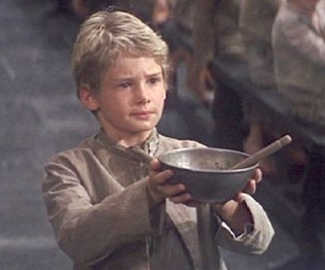
Now the Mayor draws his chair closer
Hmm… So you are not the kind of organisation that needs constant propping up? You are a stable vehicle for all kinds of programmes or messages
Unlike all those ‘worthy’ high culture organisations that keep coming back to me year after year for more money…

Slide 13

So, encouraged by this, the Director makes a tempting but strategic mistake
And I am an important part of your tourism and leisure industry

Slide 14
In reply the Mayor will certainly say…
I am fully in support of our wonderful tourism industry
but, depending on the country, may actually think…
Well tourism is an important industry. But I get more excited by advanced manufacturing, bio-technology… digital industries
Anyway tourism can look after itself

Slide 15

She explains…
Nearly everything I do is connected to
science

Slide 16
The Mayor gives a ‘tell me something new’ type shrug.…
Well sure, I know – you mean zoology, veterinary science and all that kind of “…animal stuff… “

Slide 17

But the Zoo Director cuts him off…
No, not just zoology, or even ‘just’ biology. Principles of physics, chemistry, mechanics, maths all lie beneath the living world – the animal world. And I can excite young people into careers in those areas

Slide 18

And presses home her advantage
And I can be a ‘shop window’ for partner universities … placing their huge value firmly in front of the public… who after all pay for them

Slide 19
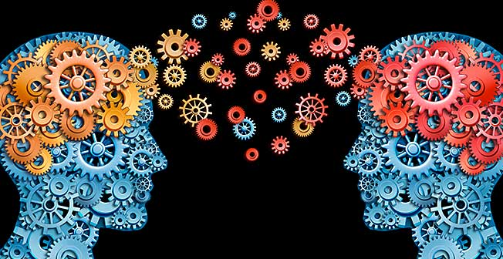
Now she has the wind behind her sales…
Like – you know – new kinds of water management technology
I can even help in the business of innovation and translation of technical knowledge into practical use and prosperity
And makes the audacious claim

Slide 20

By this time the Mayor’s mind is working furiously…
Anything that helps my city’s science base, help its citizens understand the importance of universities and research, and supports applied research so that it creates goods and services fits will my policy objectives perfectly
You know perhaps I have been overlooking something here..

Slide 21
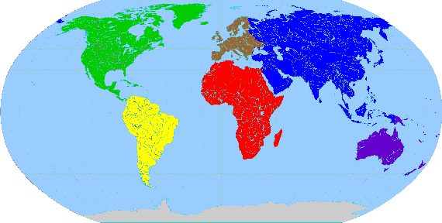
Then there are my links to other nations…zoos are not only about here: they are normally also about there

Slide 22
He pretty much shrugs again, glancing at his watch. She’s losing him. Once again he is making an assumption
Getting a bit bored again now
Well… yeah, yeah you do a great job telling visitors about the wonderful wildlife of Africa, Asia and Latin America

Slide 23
She corrects him
No, no... You don’t quite understand... Yes the experiences I offer do start with the natural heritage of those places…

Slide 24
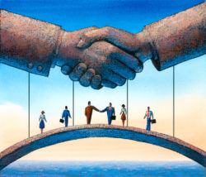
But my projects can move on to talk to my visitors = your voters about the wider culture of those countries… and their societies and their economies

Slide 25
And he thinks…
Which in turn can mean more trade links for my City... India, China, Latin America, Malaysia, Indonesia, South Africa … !
So you can help my country and my government make new types of science and cultural links with emergent economies

Slide 26
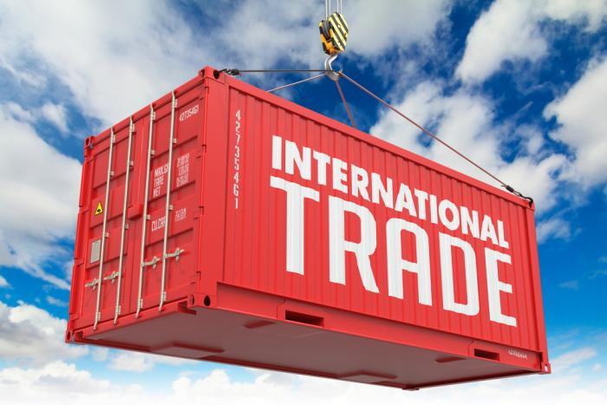
Because this is the real prize for the Mayor here..

Slide 27
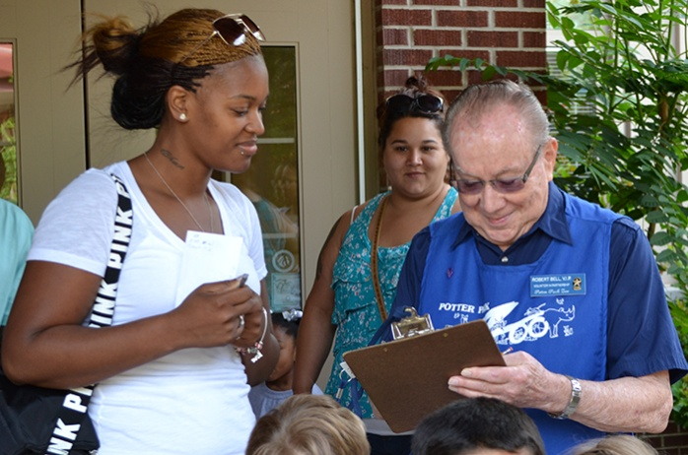

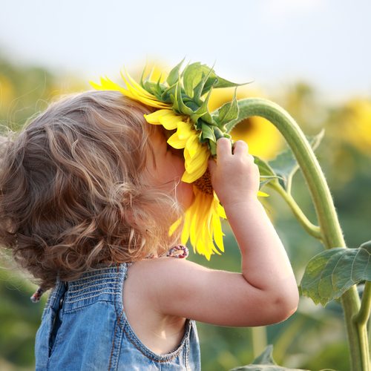
To put it very simply
I make people the people who elect you happier
a huge potential to create new social capital… to bring divergent people together … higher standards of mental, social and physical wellbeing
Then there is my social role. Think of zoos as large green oases in the middle of society, where all types of people mix together… in volunteering, in community activities, in confidence building

Slide 28



Now she comes to the topic at hand
Where better to introduce huge demographics to the carbon neutral society than a place where people already come to learn about the environment
I have to mention environmental technology… water conservation… energy efficient buildings

Slide 29
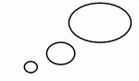
It is all coming together in the Mayor’s head
Access to voters
Help with links to trade partners
Promotes sciences, universities and innovation
Raises “gross national happiness”
Promotes sustainable water practice
Financially stable platform

Slide 30
And he can see a ‘virtuous circle’ here
Public finance available
Investment into the zoo
Innovation, science, tourism, jobs
Greater prosperity
More tax collected

Slide 31
It strikes me Madam Director, that with my help, and a little creativity on both parts, you could help me with my agenda, whilst still staying devoted to your biodiversity mission
I really could not have put it better myself, Mr Mayor!
This could be the beginning of a beautiful friendship

Slide 32
Moc děkuji!
Many thanks!
John Regan
BioParc Concepts International https://www.johnreganassociates.com/

