Slide 1

EAZA Academy, Talinn 2018
Fund raising for your in-situ projects

Slide 2
Course contents
Introduction
Session 1: Fundamental principles for success
Session 2: Overview of types of funding available
Presentation from ARTIS
Some techniques and procedures applicable to each type of funder
Presentation from Crowd Funder UK on crowd funding
Presentation and case study on funding success from Bristol Zoological Society
Group Exercises
Please ask questions as we go along, interrupt at any point
Notes:
Principles can risk seeming a bit philosophical, but at least can be made interesting
Sources of funds is very practical, but as dull as ditchwater

Slide 3
Introduction

Slide 4

Central offer of this tutorial…
There are all kinds of different sources of funding for in situ projects, and all kinds of surrounding issues
So a limitless and potentially confusing subject…

Slide 5

Aims only to be overview of some of the funds themselves and some of the skills and resources to access them
For you to select tools to make your own strategy to navigate the funding ecosystem

Slide 6
You asked…
Commitment from local government authorities to help protect a species
How to make an ‘unglamorous species sympathetic
How to create a long term partnership?
European Funds ?
Funding for running costs?
Recognising a zoo as a conservation organisation ?
Extend the size of donations and number of donors
Stronger relations with donors ?
Navigate through bureaucracy..? ?
Notes:
Anything else to add now..?

Slide 7

Tried to include answers in material
But ask questions at any time
AND Where we don’t know the answer, or have not yet provided some practical advice for your in situ project, will follow up later
Notes:
Bit Anglo-centric..?

Slide 8
Section 1: fundamental principles and attitudes
Notes:
John

Slide 9

Principle 1: You cannot be “a little bit pregnant”
Notes:
Not being really prepared for the commitment

Slide 10

So commit… which means…
Someone’s time
Realistic duration
Not dipping in and out
The commitment of others involved in the project and organisation
And…

Slide 11
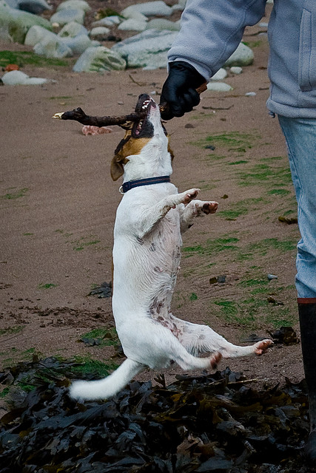
…..tenacity
See also later “about, once you established a contact, keep it…”

Slide 12

Principle 2: “Rob a bank”

Slide 13
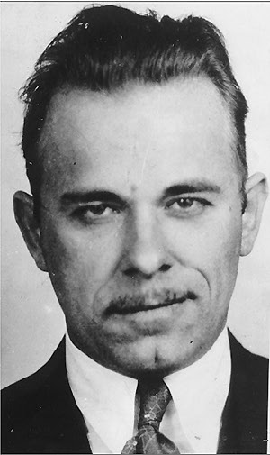
“Mr Dillinger, why do you rob banks…?”
“… because, dummy - that -
is where the money is…”

Slide 14
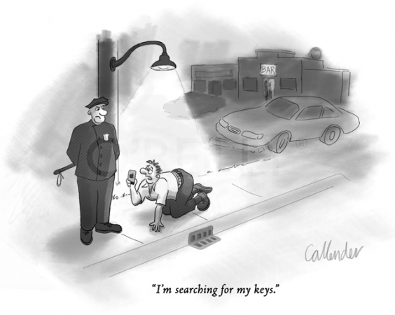
So go where a lot of money is:
Don’t disperse your limited time om the small stuff

Slide 15
Blindingly obvious, so why do people ‘scatter gun’ and go after the small stuff?
Because you yourself have only been on the receiving end of mass fundraising ( i.e. you are not rich!)
Because mass fundraising is more visible and publicised
Because bizarrely some people think fundraising is about ‘democratic inclusion’
Because the scatter gun thing will probably get you something
Because the big stuff can seem a bit scary..?

Slide 16

And because… does 100 cents somehow actually feel like more than 1 dollar…?
Furlong, E. E., & Opfer, J. E. (2009). Cognitive constraints on how economic rewards affect cooperation. Psychological Science, 20, 11 - 16.

Slide 17
So focus on the big stuff/ maximum ROI
358 billionaires have more money than the world’s poorest 2.5 billion people, more than the annual income of countries with 45% of the global population
the richest 10% account for 85% of the world’s wealth

Slide 18
Easier to raise …
€1,000,000 from 1 source
Than €1 from a million sources

Slide 19

Principle 3: Flexibility of approach

Slide 20
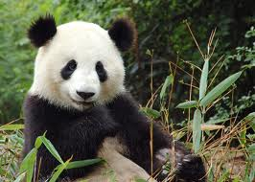
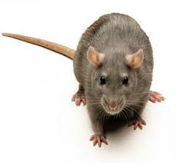
Ailuropoda melanoleuca or Rattus norvegicus…?
Opportunistic as where your resource comes from – and how you think of your project …?
Notes:
If your project … or your organisation came alive as a species, what would it be … in its attitude toward where its resource came from and how it would adapt to its environment

Slide 21

If ‘money’ itself came alive as a person
What would it be interested in..?

Slide 22
Plural identities within your in situ project…?
Heritage and culture?
Cross over into heath or agriculture
Economic development and poverty alleviation
Education
Animal welfare?
A pure biodiversity project
A chance for external interests to win in country foothold …
Place yourself at the crossroads of all relevant agenda that attract funds

Slide 23


Two ears: one mouth
“active listening”
Notes:
To orgnanisation And TO THE INDIVIDUAL –cautious…. Cultural barriers

Slide 24
As opposed to….
Please fund my tiger conservation project
Please give me your money for my project
Yammer…. Yammer….. Yammer….
External decision makers prefer their own ideas and own needs...

Slide 25

Where does your internal potential & need mesh with someone else’s external agenda…?
Internationalist
Community
Science or HE
Education
Commercial
Socio-economic
Others…?

Slide 26

Principle 4: Obliquity: getting around the No machine…
Notes:
John

Slide 27
No from me
Go higher in decision chain
Or wait me out
No to you
Get someone with more influence to ask instead ( see Principle 6)
No to this project
No to this budget
No to now
Come back with something else
Resize the project – too big – or sometimes too small…..!
Combine with someone else’s ambition
Return at appropriate time
Always come away from every encounter – even a rejection – with some kind of advantage
Notes:
On the basis of the response, you can begin to formulate a new approach.
Elicit from the decision maker what it would actually take to do the deal. If they admit to quite liking the project, ask: “What would it take to make you love the project? Is there perhaps another property that would suit them better?
In every external meeting you secure, adopt a philoshopy of bringing backsomething of value. Perhaps you were refused in your central aim of funding, but can your correspondent open other doors, give advice, act as an advocate, spread the word, etc…?

Slide 28

Principle 5: win high level champions The human fulcrum effect.
With the right friends you can move the world (… or at least get your in situ project funded)
Notes:
John…

Slide 29
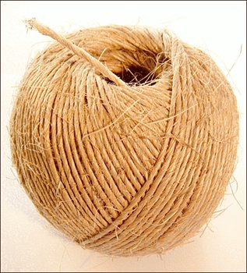
Networking: find the end of the ball of twine….
…and unravel an entire community of influential figures and ‘door openers’

Slide 30

The informal ‘advisory panel’
… door opening board… support group… contact panel … championship committee
Notes:
More about this under Section 3 ….. But worth repeating….. However clever you think you are….. Uniquely privileged in that, given subject, you can access to influence and access that normally you could not normally dream of
YOU DON’T HAVE TO DO IT ALL YOURSELF

Slide 31
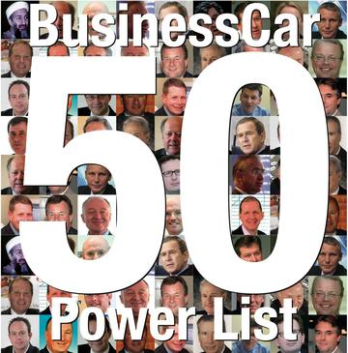
….initially just a little individual advice, a sliver of senior championship.
Seek the highest level possible; resist parochialism
Notes:
Some of these people – huge success in commerce or politics… or maybe just born rich… but they wish they had been Gerald Durrell… or Bernhard Grzimek… or Jacques Cousteau

Slide 32

Get the door open, and keep it open
Even if the specific reason for contact has come and gone…

Slide 33

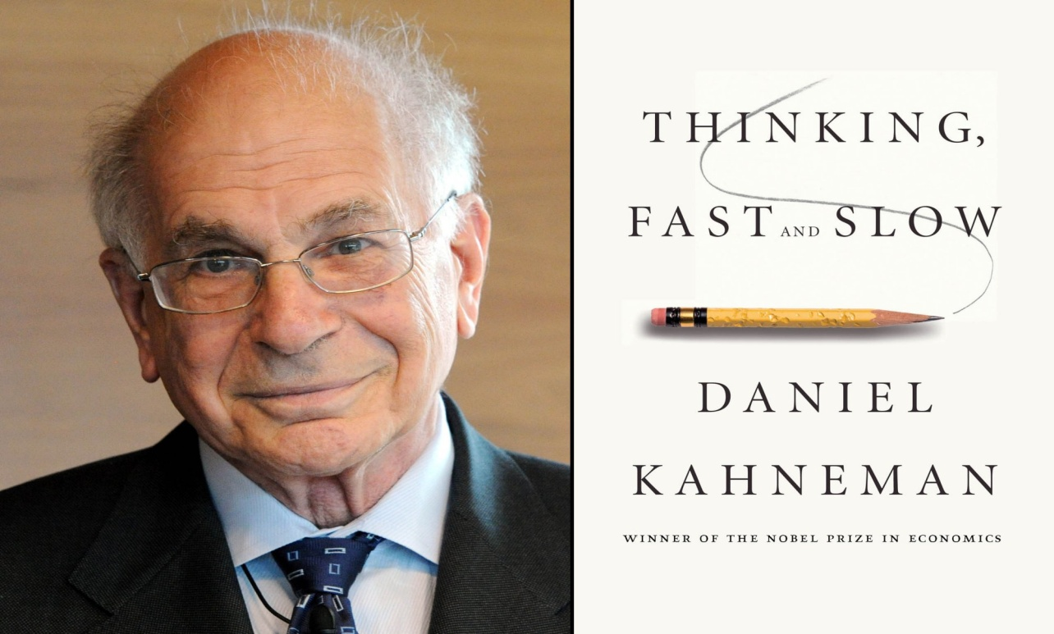
Principle 6: use “behavioural economics”…

Slide 34

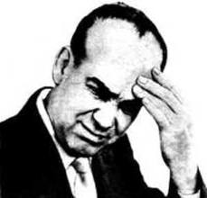
Pricing strategy: how much do you bloody ask for…?
Always float an option range with specific, aspirational higher levels…
Notes:
Worst thing that can happen when you ask for funds is that the donor says no
Second worst thing is they say yes… to your specific ask… and later you realise you could have asked for more
Jaguar story…

Slide 35
Gift Schedule technique
Donation Schedule for in country support programme: target €1 million
We appreciate that the question of philanthropic support is always a difficult one. On the one hand, if we are to actually achieve something significant on behalf of the bonobo, we must focus honestly on a practical target: on the other, the ability of individuals and organisations to give is naturally very varied and affected by all kinds of circumstances. The following ‘donation schedule’ is therefore designed to both illustrate that we will need some serious support to reach our aim, but also to allow a wide span of supporters to be generous within their means and to become involved in the project.
Number of gifts | Level | Size £ | £
1 | A | 300,000 | 300,000
3 | B | 100,000 | 300,000
4 | C | 50,000 | 200,000
10 | D | 10,000 | 100,000
18 | E | 5,000 | 90,000
Other donations | F | various | 10,000
Total |  |  | 1,000,000
Notes:
john

Slide 36
Benefits of Gift Schedule
Everyone can be “generous within their means”
Concentrates the donor’s mind on what will be needed practically to reach the target
Concentrates your own mind too (what is possible?)
Provides a range within which donor can find right level
But stretches everyone’s aspirations upwards
Takes away any embarrassment
Acts as a kind of ongoing score card
Notes:
If you wanted to raise 1,000,000 and asked 1000 people for £1,000 each what would happen?

Slide 37
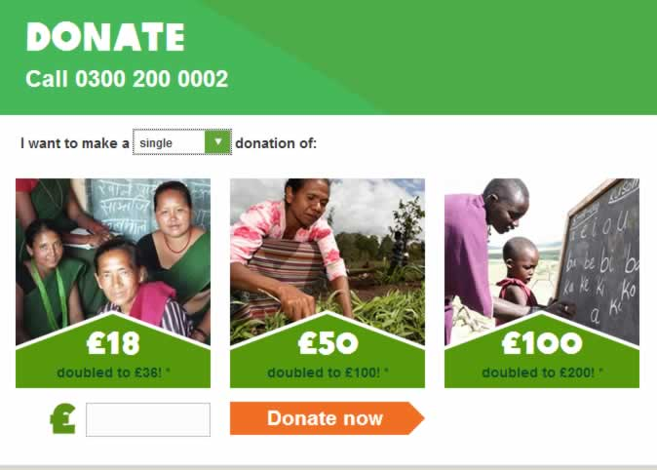
‘Nudge’ psychology…
Notes:
Why is that lower option 18… not a rounder figure… 20 or 25…
Probably this range is based on research showing that the previous average donation was, say £35…. and the charity want to nudge this average upwards… make the lower option look piffling – push enough people hovering towards the lower end up to £50.

Slide 38
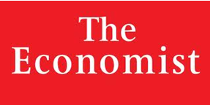
$56 | Online subscription only
$125 | Online & print subscription
$56 | Online subscription only
$125 | Online & print subscription
$125 | Print only
Decoy option
Notes:
A cognitively burdensome decision – gin’ n ‘ tonic
So when you make a proposal for a given funder – select the option you want them to choose…. And give it an ugly brother#
In the photo – make me look better
Also would work – very well in nudging people to annual membership at the zoo gate

Slide 39
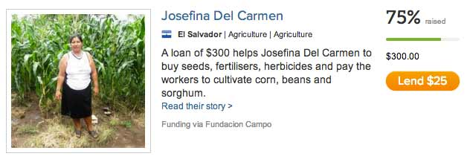

Slide 40
Higher percentage of target shown to be secured = higher the average donation:
10% of a target raised = average donation of $15
33% = average donation $26
67% = average donation of $40
Does Price Matter in Charitable Giving? Evidence From a Large-Scale Natural Field Experiment: Dean Karlan & John A List; June 2006
Each donor wants to be the one that closes the gap

Slide 41

Similarly: a phased, modular strategy because…
Can adapt to the level of funding achieved/ interest of donor
“Success succeeds”: once financial block secured, thematically extend the project

Slide 42

Principle 7: Sell the sizzle, not the sausage…
Give the donor a ‘sticky’ narrative….
Notes:
Not the dry facts of your project, but the emotional story that encapsulates the need
Benefit not features…
Emotive, not technical
A sticky, concrete, surprising emotional, narrative
Added to strong technical case for project and organisation….

Slide 43
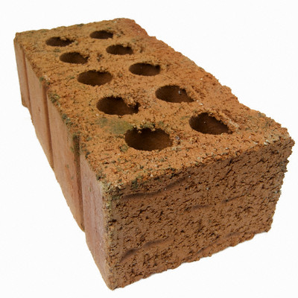
The way you tell your story
Notes:
Show one starving child, not a million

Slide 44

So a successful “sticky” story is…
Simple
Unexpected
Concrete
Credible
Emotional
A Story
Notes:
Not for technical funders of course…

Slide 45
Summary of the 7 principles
Commit the right resources
Focus your fire power on the highest return
Maintain maximum flexibility and opportunism
‘What kind of no is it?’
Ask for the championship of powerful people
Use behavioural economics
Tell a sticky story
Oh…… and there is an 8th principle
Notes:
John

Slide 46
Section 2: What are the sources of funding..?

Slide 47
A Constant State of Flux
Keeping an eye of new, existing and changing funding opportunities is a full time job
That’s why we have fundraising researchers!
Research tools:
Listserves can be good, if you have someone kind enough to share e.g. canid specialist group
Sign up to the ones who broadcast
Make it a regular piece of work. Check websites
Keep a database, ideally one that sets reminders
Network

Slide 48

4 x sources
Public Funds e.g.
EU
National programmes (eg Darwin Initiative)
Trusts and Foundations e.g.
European
USA
Geographic focus, issue focussed
Philanthropy i.e.
Major Gifts approach
Public campaigns
Corporate support
CSR
True commercial sponsorship

Slide 49

Some “health warnings” to scare you off
All programmes open to competition. Not enough to have a good project and a well written bid.
Most require match funding, and in some cases, varying forms of bank guarantees
Bidding process can be very hard work - up to an intensive 2 months of 1 person’s time at a senior level.
Notes:
John

Slide 50

Bids can be rejected due to small technical matters without any recourse to appeal
Objectives can be inflexible, and despite ( or even because of ) your imaginative approach, your bid may be marked down or rejected on technical grounds
All funded projects will at some point experience a time lag between expenditure and reimbursement
The reporting and auditing responsibilities for a funded project are quite demanding
Normally a limit on amount you can allocate to administrative support (can cost you money!!)
Notes:
Neil…

Slide 51

Trusts and Foundations USA
86,192 foundations listed
$715 billion in assets: $52 billion in grant in the year
27% supported projects outside of the USA
Environment and animals is the third highest category
Analysis is that international giving is growing
Notes:
John

Slide 52

What can you find out online?
Foundation Center of New YorK http://foundationcenter.org/ask-us/new-york
Free search (up to a point); subscribe for greater detail
Who is giving how much to whom under what terms

Slide 53
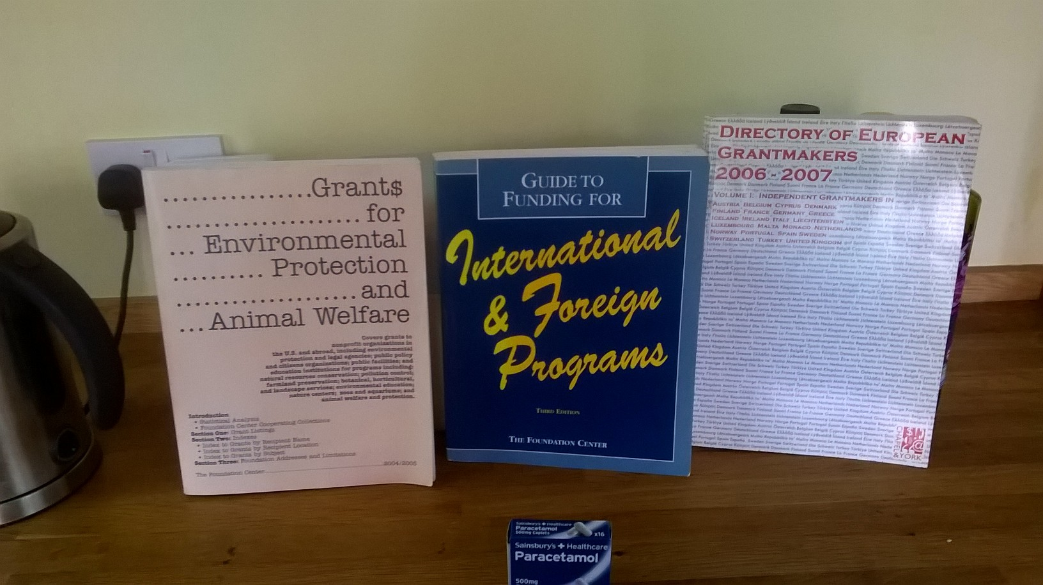
Published sources…

Slide 54

European Foundations
114,000 “public-benefit foundations”
Donate 53 billion euros per year
Many give internationally
Historic links with former colonies
Interest in development of other societies
New foundations set up every month
Rules differ in each state
EAZA Academy itself only possible thanks to Segre Foundation

Slide 55
How do you find out more..?
European Environmental Funders Group (EEFG)http://www.efc.be/
Bundesverband Deutscher Stiftungen, Working Group on Environment, Nature and Health (Germany) www.stiftungen.org
Centre Français des Fondations, Working Group on Environment (France) www.centre-francais-fondations.org
Latin American and the Caribbean Network of Environmental Funds (RedLAC) www.redlac.org
Network to find a personal contact!!

Slide 56

Philanthropic Giving
Blurs into foundations ( rich people often give that way...)
Generally (at top level in some countries) going up
Different tax incentives in different countries
Different cultural attitudes to giving
Rich in many countries getting richer ( ...!)
But giving more away ( ...!)
And actually the macro trends do not matter, your strategy and your degree of effort do
Notes:
Avoid the obvious and oversubscribed …. R Branson is NOT the only rich person on Earth
Segment different kinds of HNIs
Inherited
Self made
Corporate v City
Life stage…

Slide 57

Why do individuals give to wildlife conservation?
Because the right person asks them..?
Peer pressure/ social acceptance..?
To show they can/ assert dominance..?
Guilt..?
Mortality/ immortality ..?
Because they really believe in your work..?
Because they are already connected to your work or organisation..?
Because they want to become connected… feel involved
Notes:
Thanking strategy very importnt – 9 different ways … over 18 months

Slide 58

A process of “outsiders” becoming “insiders”

Slide 59

Corporate giving
Don’t overestimate potential in corporate giving
Burden of sponsor management…
But specific opportunities for in situ projects
€ 2 billion a year
Sponsorship or CSR..?
Notes:
Neil .. … throw back and forth between…
Your project is all about a partnership between your country and the developing country – there will be commercial interests valuing this…

Slide 60

Corporate support
‘Chairman’s spouse no longer as important (or is it?)
Organisational needs; individual needs – have to satisfy them both
Staff turnover can be an issue
Less restrictive than donor calls, probably not as onerous in terms of reporting, but requires high level of servicing
Can be dropped at any time – long term engagement rare

Slide 61


Myth = companies only give for hard and fast business reasons.
Received wisdom
Reality = you are dealing with illogical, emotional primates
Notes:
Pizza Express story …

Slide 62

What kind of company fits your in situ country.?
A business from your country that has an interest in the range country..?
A business (or individual business figure..?) from the range country that has a presence in your country…
Extractive industries
Airlines and travel
Animal related brands
Any interest with a lot of employees in the area
Notes:
John = throw back to Neil…

Slide 63
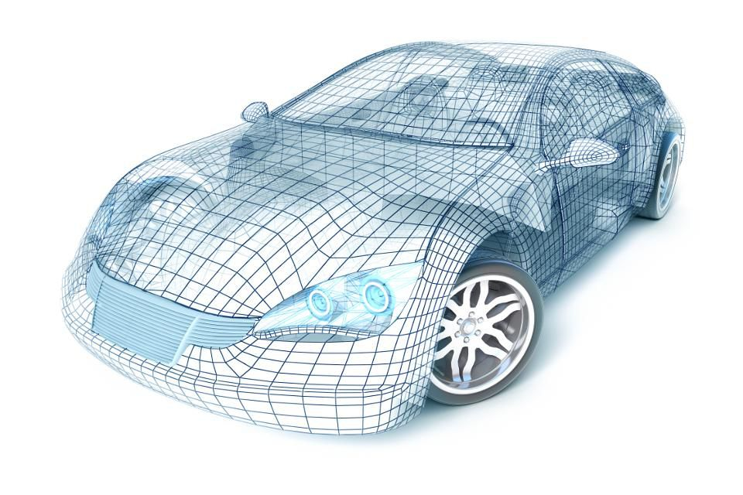

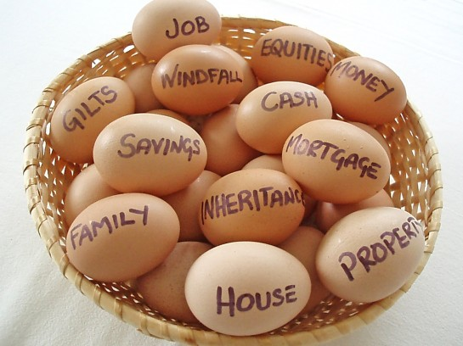

Some kinds of company that allocate a specific sponsorship budget from the outset..?
Automotive
Financial products
Clothing
Drinks
Notes:
John

Slide 64
More info and downloads on website: http://www.johnreganassociates.com/downloads/ Bottom of page!
10 steps for sponsorship for zoos
The sponsor’s perspective: interview with the late Sir Nick Scheele of Jaguar and Ford
How Skansen won its 4 million euros
Interviews with successful fund raising zoo directors
And lots more stuff…

Slide 65
Section 3: A quick look at some practical techniques (applying the principles in Section 1 to the funding sources in Section 2)

Slide 66


Knocking on lots of doors when in range country…
Add 2 days to your in situ trip for meetings with potential funders there
Spend some time in advance researching, contacting and setting up meetings
Which other organisations are working in the same area? Any opportunity to collaborate?

Slide 67

Make advance appointments with:
your own country’s Embassy
EU delegation
USA and other big economies (China?)
Businesses from your country (& other big economies) investing into country
Any other significant individual or organisation bridging here and there

Slide 68
All kinds of existing ‘your country/ range country’ networks exist
http://www.chamber-commerce.net/dir/488/German-Brazilian-Chamber-of-Commerce-and-Industry-in-Rio-De-Janeiro
http://www.mfcci.com/malaysia-france/malaysia-france-trade/
http://www.spaincc.org/ Spanish-South African Chamber
Who works where and what are their priorities? Give them a reason to talk with you
Notes:
The top 10 companies would want to establish foothold or to affirm their existing presence
Probably ask for any advice and help rather than bluntly for money… perhaps help in kind….. Bored corporate representatives in country

Slide 69

Public Funds
• Broad and flexibly minded research
• Go and meet decisions makers and officials ( = illogical primates!)
• Make a point of going to EC delegation and embassies
• Develop wider partnerships where appropriate and possible alliances – donors like to see collaborations, not territoriality
Notes:
John – the throw to Neil

Slide 70

Trusts and Foundations
• Research - do it yourself, or buy it in
Read carefully (check words back)
• Personal connection
• Uniqueness of purpose (replicable prototype..?)
• Clear beneficiaries
• DON’T BLANKET BOMB
• Polite persistence
• Well written proposal
• 501c3 needed for US foundations
Notes:
Jo

Slide 71
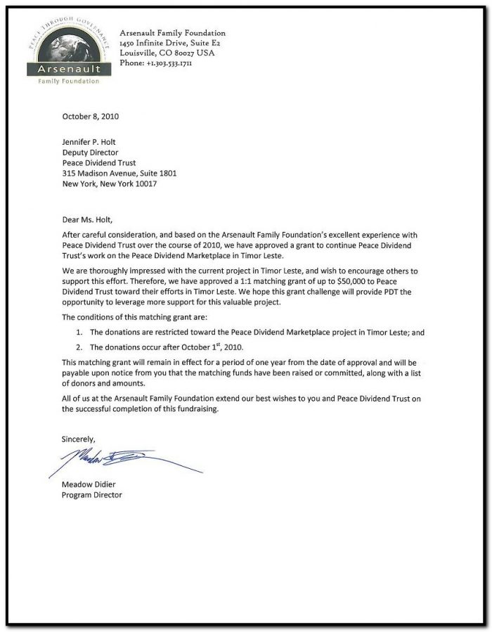
What does a foundation proposal look like..?
Covering letter (very brief summary)
Proposal itself
Executive Summary (may itself trigger a positive or negative decision)
Organisational aims and credentials (be brief - don’t ‘peacock’)
Overall, compelling need to be addressed

Slide 72

Specific Objectives - measurable if possible
Specific Actions that well address specific Objectives and the Need
Evaluation - How will success be assessed and against which standards
Detailed budget
Exit strategy

Slide 73

Philanthropic giving – individual high level donors
• Much “easier” in many ways, if you have the courage to ask
The craft of major gifts highly developed. Many techniques – lots of good books
• Research, networking, personal recommendations (read the papers!) Avoid the usual subjects
• Advisory group
• Prestigious central located event to kick start relationships (don’t charge, no raffles or auctions)
• The Gift Schedule
• Creative thanking, involvement and stewardship
Notes:
Richard Branson is not the only rich person in the world…..!!!
Asking is scary – especially face to face … that is why everyone writes letters – which hardly ever work
Thanking – research – thank a donor 9 times in 9 different ways over a period of 18 months… before you ask again
Making the thanks as imaginative and personal as possible – go back to Sticky Sucess

Slide 74

The Advisory or Development Board
Coalesce a group of well connected figures
Probably initially ask only for advice, not funds
Network from one to the other
Allow time for them to become involved with project
Ask them to ask on your behalf
Ask them to help organise a high profile event ( and maybe to pay its costs…?)
Notes:
The most powerful of all techniques

Slide 75
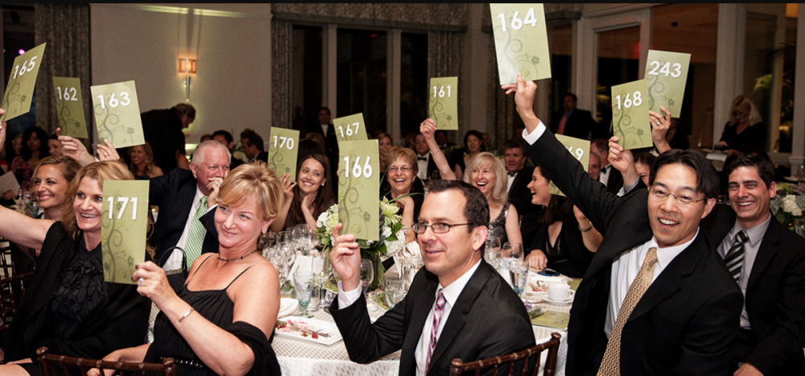
The fundraising event
Find the most compelling host (s) and venue you can
Spend a lot of time researching a really good guest list
Don’t charge for the event
Don’t do a raffle or auction
Make it quite clear that you are asking for funding
Use a Gift Schedule
Notes:
jioh

Slide 76
Parting thoughts…

Slide 77
Will any of this stuff actually work? Or will you ever get round to trying it out?
Back to the day job
Creating an action plan
“Knowledge problem” v “Action problem”
Better ROI than any other economic activity pursued by the human primate, other than
Winning a lottery
Theft

Slide 78
Ends

Slide 79
Resources Page
A template for full cost recovery budgeting: ://www.wcva.org.uk/media/2017262/full-cost-recovery-a_guide_and_toolkit.pdf
Advice asking letter template
How to put together a fundraising advisory board
Some useful publications:
Wealth Watch
Credit Suisse Annual Wealth Survey
Forbes Billionaire Report

Slide 80
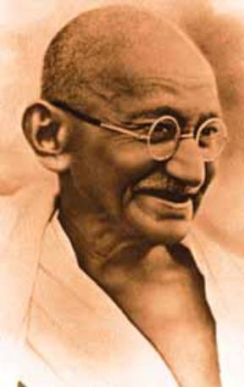
“If you don’t ask, you don’t get”

